Slide 1


CS214 – Data Structures
Lecture 03: Complexity
Slides by
Ahmed Kamal, PhD
Mohamed El-Ramly, PhD
Basheer youssef PhD
Notes:
Polls in slides:
in lecture 1: 24,29,31,32,42,46
in lecture 2: 65,84,102,103,108,117,130

Slide 2


Slide 3
Lecture 3 Outline
Math Revision (1.2, 1.3)
Algorithm Complexity

Slide 4
I. Math Revision

Slide 5
Mathematical Background*
Set concepts and notation
Logarithms
Summations
Recursion
Induction Proofs
Notes:
Look over Chapter 2, read as needed depending on your familiarity with this material.
A set has no duplicates, a sequence may have duplicates.
Logarithms: We almost always use log to base 2. That is our default base.

Slide 6

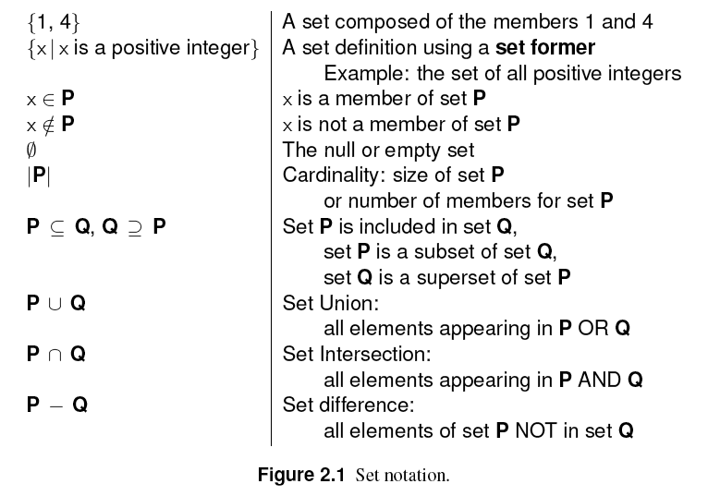
1. Set
A set is a collection of distinguishable members or elements.

Slide 7
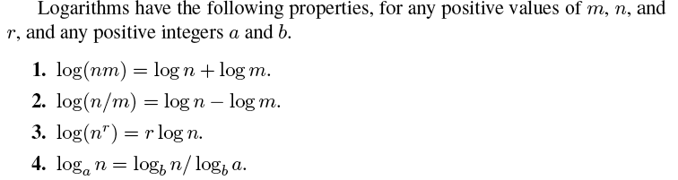
2. Logarithm
Definition:

Slide 8
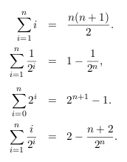
3. Summation

Slide 9
4. Recursion
An algorithm is recursive if it calls itself to do part of its work.
Example:
1. Compute n!
2. Hanoi puzzle

Slide 10
5. Mathematical Proof
Three templates for mathematical proof
  Proof by mathematical induction
  Proof by Counterexample
  Proof by Contradiction
Read Weiss, 1.2.5

Slide 11
1. Proof by Induction
A proof by induction has two standard parts.
  Proving a base case, that is, establishing that a theorem is true for a small value
  An inductive hypothesis is assumed. This means that the theorem is assumed to be true for all cases up to some limit k.
Using this assumption, the theorem is shown to be true for the next value, k + 1.
This proves the theorem for finite k.

Slide 12
Example1 of Proof by Induction
Prove that Fibonnaci numbers
F₀ = 1, F₁ = 1, F₂ = 2, …… F_{i} = F_{i-1} + F_{i-2}
Satisfy F_{i} < (5/3)^{i} for i ≥ 1

Slide 13
Example1 of Proof by Induction
Base case F₁ = 1 < (5/3)¹
Base case F₂ = 2 < (5/3)² < (25/9)
Inductive hypothesis: assume the theorem is true for i = 1, 2, .., k
To prove this we need to prove that
F_{k} < (5/3)^{k}

Slide 14
Example1 of Proof by Induction
Base case F₁ = 1 < (5/3)¹
Base case F₂ = 2 < (5/3)² < (25/9)
Inductive hypothesis: assume the theorem is true for i = 1, 2, .., k
To prove this we need to prove that
F_{k} < (5/3)^{k}

Slide 15
Example1 of Proof by Induction
F_{k} = F_{k-1} + F_{k-2}
Using the inductive hypothesis:
F_{k} < (5/3)^{k-1} + (5/3)^{k-2}
F_{k} < (5/3)^{k-2} (5/3 + 1)
F_{k} < (5/3)^{k-2} (8/3)
But 8/3 < 25/9
F_{k} < (5/3)^{k-2} (25/9)
F_{k} < (5/3)^{k-2}(5/3)²
F_{k} < (5/3)^{k}

Slide 16
2. Proof by Counterexample
F_{k} ≤ k² is false
F₁₁ ≤ (11)² is false because F₁₁ = 144

Slide 17
3. Proof by Contradiction
Proof by contradiction proceeds by assuming that the theorem is false.
Then it shows that this assumption implies that some known property is false, and hence the original assumption was erroneous.

Slide 18
3. Proof by Contradiction
Theorem: There is no largest integer.
Step 1:
  Contrary Assumption: Assume this is false.
  Assume that there is a largest integer, B.
Step 2:
  Show this assumption leads to a contradiction
  Consider C = B + 1. C is an integer because it is the sum of two integers.
  Also C > B, which means that B is not the largest integer.
  Contradiction! hence the theorem is true.

Slide 19
Introduction to Algorithm Complexity

Slide 20
Lecture Objectives
To precisely define the term algorithm
To specify the main characteristics of algorithms
To estimate the time and space complexity of algorithms
To get familiar with asymptotic rate growth of functions and algorithms
To introduce the big-oh, Theta, and Omega operators to measure the worst, average and best time complexity of algorithms
To classify algorithms based on their time complexities
To learn how to solve recurrence relations and estimate the complexity of recursive algorithms

Slide 21
Algorithms
An algorithm is a finite sequence of instructions that, if followed, accomplishes a particular task
Algorithms must satisfy the following criteria:
  Input – Zero or more quantities are externally supplied.
  Output – At least one quantity is produced.
  Definiteness – Each instruction is clear and unambiguous.
  Finiteness – If we trace out the instructions of an algorithm, then for all cases, the algorithm terminates after a finite number of steps.
  Efficiency – The algorithm must consume a reasonable amount of resources and takes a reasonable of time. It must be feasible to run the algorithm.

Slide 22
Solving Problems by Computers
So, we use algorithms to solve problems
A problem is defined in principle as a task that is amenable to being solved by a computer, e.g.
  Sorting a list of numbers
  Searching for a particular key value in a collection of items
  Finding the shortest distance between two cities in a map
Not all problems are solved by computers, computer scientists discovered that
  Some problems are easy to solve
  Other problems are hard to solve since they take a lot of time
  A group of problems cannot be solved because we cannot design algorithms for them

Slide 23
Problem vs. Problem Instance
We should differentiate between a problem (general description of a task) and its instances (a particular case with specific set of input data)
Example #1:
  Problem: Sort a collection
  Problem instance: sort the list [5,2,1,7,3] in ascending order
Example #2:
  Problem: Search for a key value in a collection
  Problem instance: given key=3, find this key in the sorted list [1,2,6,9,10,45,78]

Slide 24
Algorithm Complexity
The term complexity refers to the amount of recourses required by an algorithm to solve a problem instance
  The term time complexity refers to the amount of time needed to solve a problem instance
  The term space complexity refers to the amount of memory needed to solve a problem instance

Slide 25
Estimation of Time Complexity
Since an algorithm is a sequence of instructions written by a pencil on a piece of paper and cannot be executed directly to measure its performance, we are faced with the following challenges:
  How to measure an algorithm performance?
  What are the units of measurement, is it seconds, or any other units?

Slide 26
Approach #1
Implement a program for this algorithm and run it for different instances of the problem under study
Analysis
  Very expensive approach
  Depends on the machine architecture, current technology, type of programming language used, the programmer skills, etc.
All of the abovementioned reasons lead to the conclusion: This approach is not practical!!
.

Slide 27
Approach #2
Select the most fundamental operation done by the algorithm, then count the number of times this operation takes place to solve a problem instance of size n
  Not all operations are equal. E.g. the CPU time to do a multiplication is longer than the addition operation
  Nevertheless, if the addition operation is more frequent than the multiplication operation, the total time taken to execute all additions adds up and dominates the total time taken to execute the multiplication operations, so fundamental means dominant!

Slide 28
Approach #2
In this approach, we use the number of times the fundamental operation is executed as a measure of time complexity. It is not measured in seconds (or any other time units)
Example
    Algorithm add( x[ ], n)
    Sum ← 0
    For (i←0; i<n; i←i+1)
      Sum ← x[i]+Sum
    End for
    Return Sum
If the fundamental operation is the ← operation, then time complexity T(n)=1+[(n+1+1)]+n=2n+3
Notes:
Removed the callout illustration:
If the fundamental operation is the + operation, then time complexity T(n)=2n

Slide 29
If the fundamental operation is the +
Then T(n) will be:
Algorithm add( x[ ], n)
Sum ← 0
For (i←0; i<n; i←i+1)
  Sum ← x[i]+Sum
End for
Return Sum
Notes:
2n

Slide 30
Approach #2
Analysis:
  People may choose different fundamental operations for the same algorithm, so you may get more than one time complexity function for the same algorithm!
  Again, this approach depends on the architecture and the technology used, if for example we design a machine that executes * operation faster than + operation, our analysis will not be same!
Does it make any difference if someone tell you that the time complexity of an algorithm A is T(n)=3n+2 and somebody else insisted that it is T(n)=2n?
Do you have to know the fundamental operation that the analysis is based on?

Slide 31
Let’s continue approximating…
Easy is Good and Fast! Since we are satisfied with a rough estimate, how about simplifying the time complexity function further by ignoring all the coefficients!!!
  So, if an algorithm has time complexity T(n)=4n²+100, we simply say the time complexity is approximated to T(n)≈n²
To do that, we need some mathematical justification or reasoning!!!

Slide 32
Term Contribution
Assume the actual time complexity of an algorithm is T(n) = 3n²+8n+10, what is the approximate time complexity of that algorithm?
  Since T(n) is getting bigger (i.e. monotonically increasing) by increasing the problem size n, we can study the contribution of each term; 3n², 8n, and 10, on the increase of T(n)

Slide 33
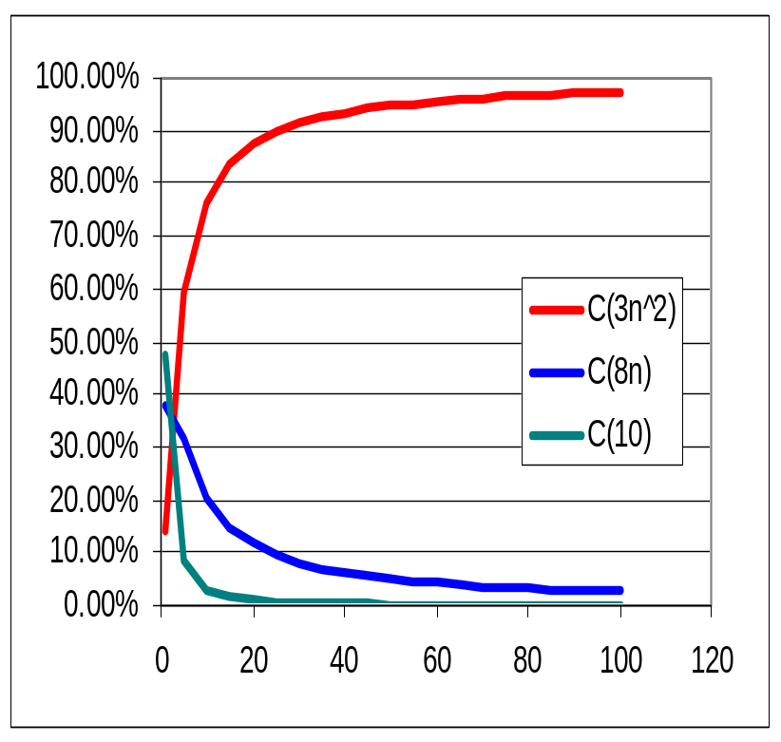
Experiment#1
n | 3*n^2 | 8*n | 10 | T(n) | C(3n^2) | C(8n) | C(10)
1 | 3 | 8 | 10 | 21 | 14.29% | 38.10% | 47.62%
5 | 75 | 40 | 10 | 126 | 59.52% | 31.75% | 8.73%
10 | 300 | 80 | 10 | 392 | 76.53% | 20.41% | 3.06%
15 | 675 | 120 | 10 | 808 | 83.54% | 14.85% | 1.61%
20 | 1200 | 160 | 10 | 1374 | 87.34% | 11.64% | 1.02%
25 | 1875 | 200 | 10 | 2090 | 89.71% | 9.57% | 0.72%
30 | 2700 | 240 | 10 | 2956 | 91.34% | 8.12% | 0.54%
35 | 3675 | 280 | 10 | 3972 | 92.52% | 7.05% | 0.43%
40 | 4800 | 320 | 10 | 5138 | 93.42% | 6.23% | 0.35%
45 | 6075 | 360 | 10 | 6454 | 94.13% | 5.58% | 0.29%
50 | 7500 | 400 | 10 | 7920 | 94.70% | 5.05% | 0.25%
55 | 9075 | 440 | 10 | 9536 | 95.17% | 4.61% | 0.22%
60 | 10800 | 480 | 10 | 11302 | 95.56% | 4.25% | 0.19%
65 | 12675 | 520 | 10 | 13218 | 95.89% | 3.93% | 0.17%
70 | 14700 | 560 | 10 | 15284 | 96.18% | 3.66% | 0.16%
75 | 16875 | 600 | 10 | 17500 | 96.43% | 3.43% | 0.14%
80 | 19200 | 640 | 10 | 19866 | 96.65% | 3.22% | 0.13%
85 | 21675 | 680 | 10 | 22382 | 96.84% | 3.04% | 0.12%
90 | 24300 | 720 | 10 | 25048 | 97.01% | 2.87% | 0.11%
95 | 27075 | 760 | 10 | 27864 | 97.17% | 2.73% | 0.10%
100 | 30000 | 800 | 10 | 30830 | 97.31% | 2.59% | 0.10%
As problem size n increases, the contribution of 3n² term increases and other terms decrease!

Slide 34
Experiment#1
Observation:
  As n→∞ the term 3n² dominates (i.e. approaches 100%) while the other terms decease (i.e. approaches 0%)
Conclusion:
  We can ignore the lower degree terms from the complexity function as n→∞
  This leads to the first approximation of the previous complexity function to T(n)≈3n²
Now how about the coefficient 3?

Slide 35
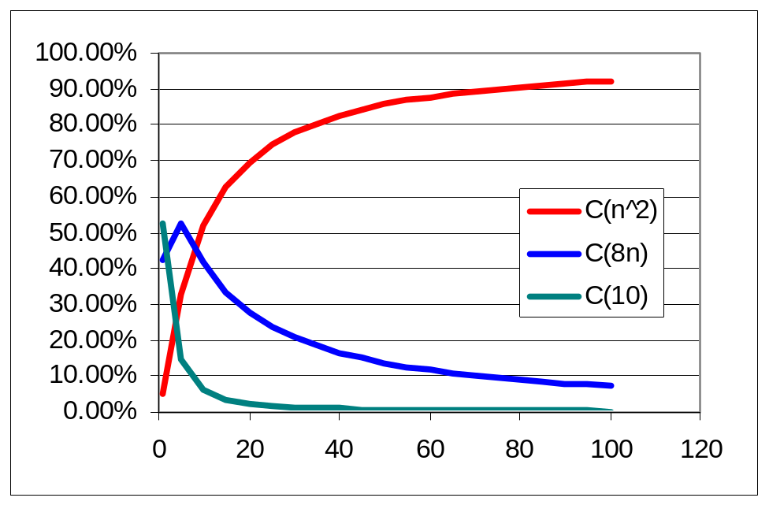
Experiment#2
n | C(n^2) | C(8n) | C(10)
1 | 5.26% | 42.11% | 52.63%
5 | 32.89% | 52.63% | 14.47%
10 | 52.08% | 41.67% | 6.25%
15 | 62.85% | 33.52% | 3.63%
20 | 69.69% | 27.87% | 2.44%
25 | 74.40% | 23.81% | 1.79%
30 | 77.85% | 20.76% | 1.38%
35 | 80.49% | 18.40% | 1.12%
40 | 82.56% | 16.51% | 0.93%
45 | 84.23% | 14.98% | 0.79%
50 | 85.62% | 13.70% | 0.68%
55 | 86.78% | 12.62% | 0.60%
60 | 87.76% | 11.70% | 0.54%
65 | 88.61% | 10.91% | 0.48%
70 | 89.35% | 10.21% | 0.44%
75 | 90.00% | 9.60% | 0.40%
80 | 90.57% | 9.06% | 0.37%
85 | 91.09% | 8.57% | 0.34%
90 | 91.55% | 8.14% | 0.32%
95 | 91.96% | 7.74% | 0.30%
100 | 92.34% | 7.39% | 0.28%
If we ignore the coefficient of the highest degree term, it still dominates the other two terms as n is getting bigger

Slide 36
Experiment#2
Observation:
  Ignoring the coefficient of the highest degree term does not affect the contribution of that term on the growth of the complexity function T(n), i.e. it still dominates the other two terms as long as n→∞
Conclusion:
  As n→∞ we can simply drop the coefficient of the highest degree term since it is still dominating the other terms in the complexity function and therefore T(n)≈n²

Slide 37
The Effect of the Problem Size (n)
So as the problem size n increases, we can approximate the complexity function, but what is the minimum problem size beyond which we can approximate????
For example, in the previous example, we know that the exact time complexity is T(n) = 3n²+8n+10 and the approximate one is T(n)≈n², what is the minimum problem size n that satisfies this approximation?

Slide 38
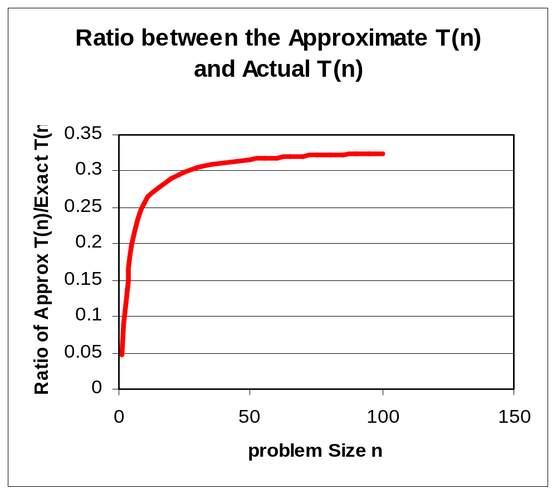
Experiment#3
Draw Approximated T(n) over Exact T(n) as n increases
As you can see, when n is beyond a certain value, the ratio=0.33 starts to stabilize
We conclude from this experiment that the approximated T(n) is growing with the same rate as the actual T(n) when the problem size is around 25 or more

Slide 39
Rate of Function Growth
Generally speaking, mathematicians when they studied functions, they decided to group these functions according to their rate of growth
This field of science is known as asymptotic growth of functions
We will focus on three important asymptotic notations:
  Big-oh Notation: O(f(n))
  Theta Notation: θ(f(n))
  Omega Notation: Ω(f(n))

Slide 40
Big-oh Notation
Let g(n) be a function
The set O(g(n)) is defined as
In other words, f (n) ∈O(g(n)) if and only if there exist positive constants c, and n₀, such that for all n≥n₀, the inequality 0≤f(n)≤ cg(n) is satisfied
We say that f (n) is Big-Oh of g(n), or that g(n) is an asymptotic upper bound for f (n)

Slide 41
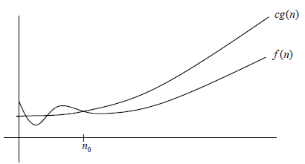
Big-Oh Notation
We use the big-Oh notation to study the worst-case time complexity of an algorithm:
When we say that the worst-case time complexity of an algorithm A is O(n²) we mean: “We don’t know the exact time complexity of the algorithm A but we can assure that when the problem instance size exceed n₀, it is not higher than cn²
Starting from n₀,
the f(n) ≤ cg(n)
This area represents the set
of all functions that growing
no faster than cg(n)

Slide 42
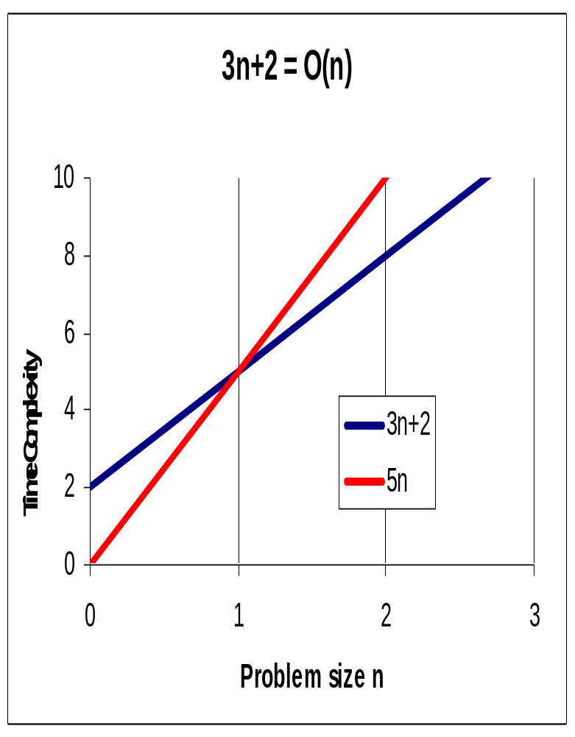
Example 1
Prove that f(n)=3n+2 is an element of O(n)
Proof:
  We need to find two real numbers n₀>0 and c>0 where the inequality 0≤f(n)≤cn is fulfilled
  Take n₀=1 and c=5 ➔ 0≤3n+2≤5n
  Since the inequality is fulfilled with n₀=1 and c=5, therefore f(n)ЄO(n)

Slide 43
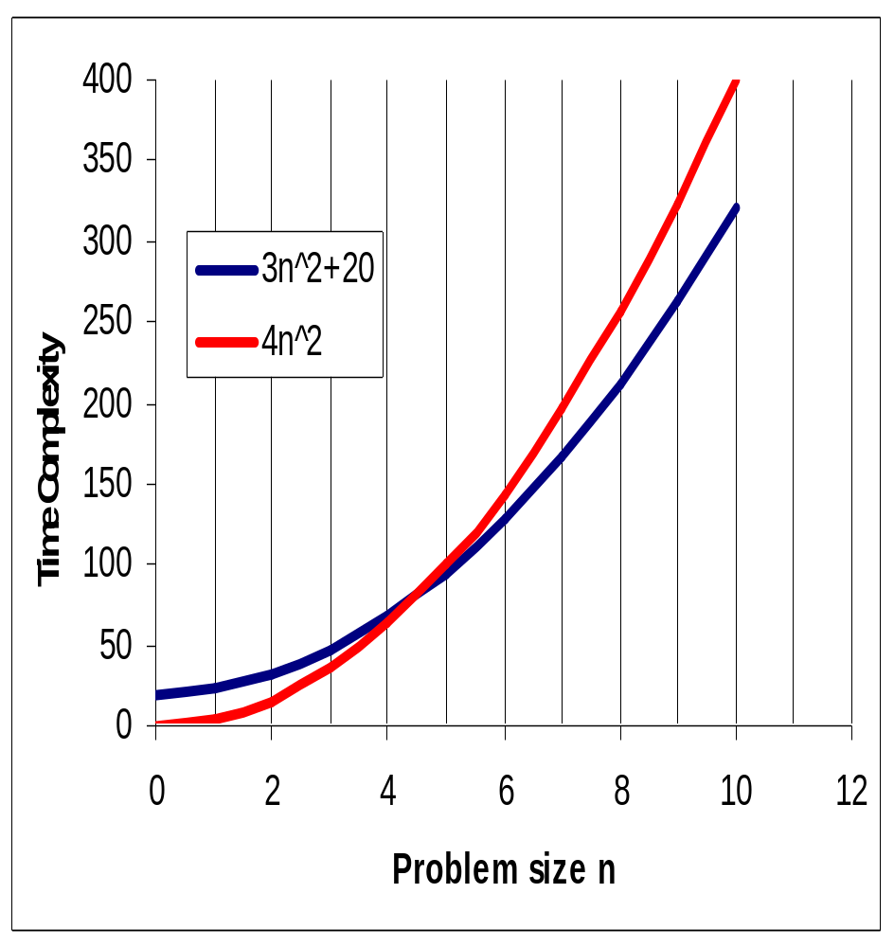
Example 2
Show that f(n)=3n²+20 has O(n²)
  We need to find two real numbers n₀>0 and c>0 where the inequality 0≤ 3n²+20 ≤cn² is fulfilled
  Let n₀=5 and c=4
  ➔ 0≤ 3n²+20 ≤4n²
  ➔ 3n²+20 ∈ O(n²)

Slide 44
What is the time complexity of multiplying two arrays of size n?
Algorithm multiply (x[], y[], n)
sum ← 0;
for (i=0; i<n; i++)
sum ← sum +x[i]*y[i];
return sum;
Notes:
2n+2
1+[1+n]+n

Slide 45
What is the big-oh of multiplying two arrays of size n?

Slide 46
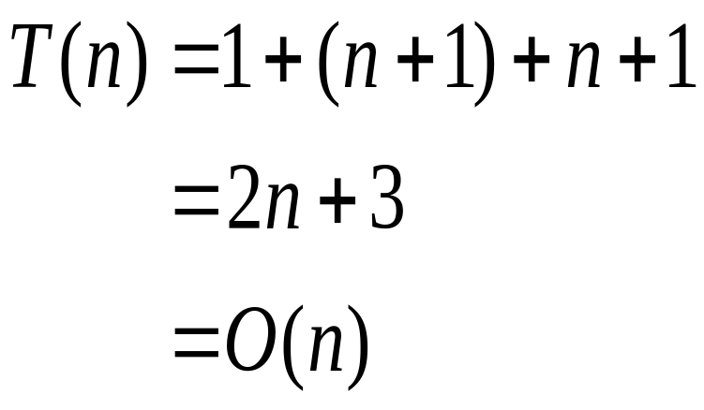
Example 3
What is the big-oh of
multiplying two arrays of size n?
Algorithm multiply (x[], y[], n)
sum ← 0;
for (i=0; i<n; i++)
sum ← sum +x[i]*y[i];
return sum;

Slide 47
Some Big-Oh Rules
Rule#1:
O(f(n))+O(g(n)) = O(f(n)+g(n))
The above rule simply says that if you have two algorithms that are executed one after the other and one of them has O(f(n)) and the other one has O(g(n)) then the overall complexity of these two algorithms is the big-oh of the sum of f(n) and g(n)

Slide 48
Example 9: Reading then Sorting an Array
Algorithm readArray (x[], n)
for(i=0; i<n; i++) read x[i];
return;
Algorithm Sort(x[], n)
for (i=0; i<n; i++)
for (j=0; j<i; j++)
if (x[j]>x[i])
swap(x[i],x[j]);
return;
The time complexity of readArray algorithm = O(n)
The time complexity of sort algorithm = O(n²)
The time complexity of reading then sorting the array is O(n+n²)=O(n²)

Slide 49
Some Big-Oh Rules
Rule #2:
O(f(n))*O(g(n))=O(f(n)*g(n))
This rule is applied when one algorithm with complexity O(f(n)) is calling another algorithm with complexity O(g(n))

Slide 50
Example 10
Algorithm
Read_sort_write (n, m)
for (array←1; array <= m; array++)
readArray (x, n);
sortArray( x,n);
printArray(x, n);
return;
T(readArray) = O(n)
T(sortArray)=O(n²)
T(printArray)=O(n)
T(read+sort+print)=O(n+n²+n)=O(n²)
The above three algorithms are
executed m times
Therefore the overall time complexity of Read_sort_write algorithm is O(m*n²)

Slide 51
Example 11
Algorithm
Read_sort_write (n, m)
for (array←1; array <= m; array++)
readArray (x, n);
sortArray( x,n);
printArray(x, n);
return;
T(readArray) = O(n)
T(sortArray)=O(n²)
T(printArray)=O(n)
T(read+sort+print)=O(n+n²+n)=O(n²)
The above three algorithms are
executed m times
Therefore the overall time complexity of Read_sort_write algorithm is O(m*n²)

Slide 52
Example 12
What is the time complexity of:
sum = 0;
for (k=1; k<=n; k*=2) // Do log n times
for (j=1; j<=n; j++) // Do n times
sum++;
O(n^2)
O(n)
O(log n)
O(n log n)

Slide 53
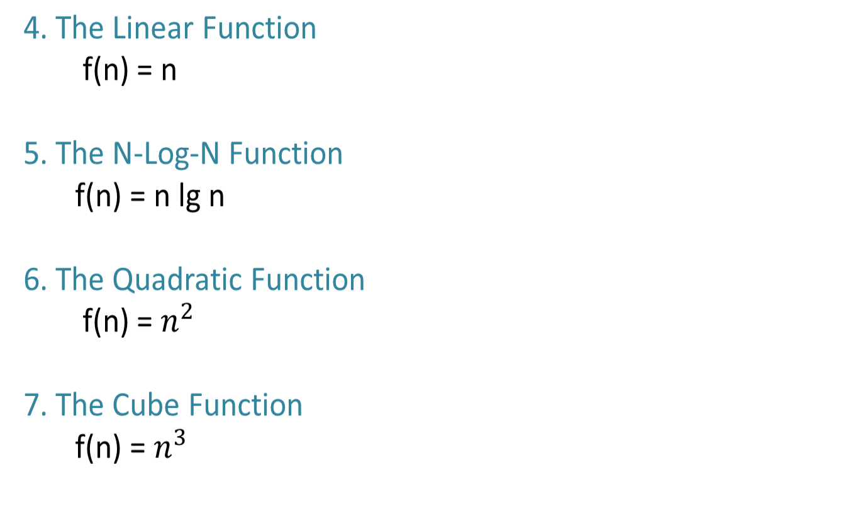
7 functions used in analysis of algorithms
1. The exponential function
f(n) = 2^{n}
2. The logarithmic function
f(n) = log_{b} n,
The most fundamental
logarithmic function is
g(n) = log₂ n
3. The Constant Function
f(n) = c, c is a constant
The most fundamental
constant function is
g(n) = 1

Slide 54
7 functions used in analysis of algorithms
Comparing the growth of the running time as the input grows to the growth of known functions.
Input Size: n | (1) | log n | n | n log n | n² | n³ | 2ⁿ
5 | 1 | 3 | 5 | 15 | 25 | 125 | 32
10 | 1 | 4 | 10 | 33 | 100 | 10³ | 10³
100 | 1 | 7 | 100 | 664 | 10⁴ | 10⁶ | 10³⁰
1000 | 1 | 10 | 1000 | 10⁴ | 10⁶ | 10⁹ | 10³⁰⁰
10000 | 1 | 13 | 10000 | 10⁵ | 10⁸ | 10¹² | 10³⁰⁰⁰

Slide 55
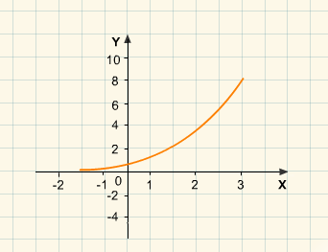
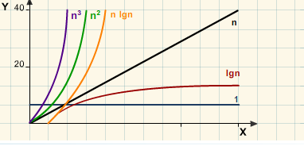
7 functions used in analysis of algorithms
2ⁿ

Slide 56
Example 11: Comparing Algorithm Efficiency
Consider the following 3 Algorithms for computing 1+2+…+n , n > 0
Algorithm A
sum = 0 for i = 1 to n sum = sum +i

Slide 57
Example 11: Comparing Algorithm Efficiency
Consider the following 3 Algorithms for computing 1+2+…+n , n > 0
Algorithm A | Algorithm B
sum = 0 for i =1 to n sum = sum +i | sum = 0 for i = 1 to n {for j =n to i sum = sum +1 }

Slide 58
Example 11: Comparing Algorithm Efficiency
Consider the following 3 Algorithms for computing 1+2+…+n , n > 0
Algorithm A | Algorithm B | Algorithm C
sum = 0 for i =1 to n sum = sum +i | sum = 0 for i = 1 to n {for j =n to i sum = sum +1 } | sum = n * ( n +1)/ 2

Slide 59
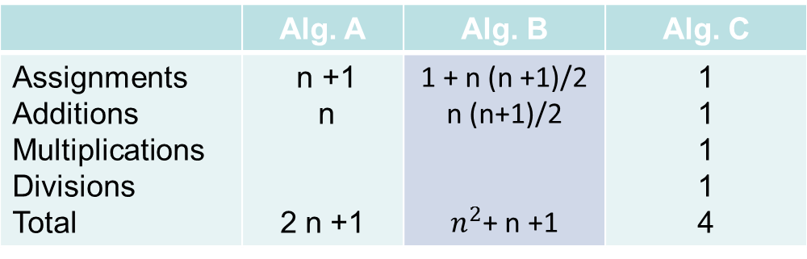
Example 11: Comparing Algorithm Efficiency
Consider the following 3 Algorithms for computing 1+2+…+n , n > 0
The number of operations required in each algorithm is
Algorithm A | Algorithm B | Algorithm C
sum = 0 for i =1 to n sum = sum +i | sum = 0 for i = 1 to n {for j =n to i sum = sum +1 } | sum = n * ( n +1)/ 2

Slide 60
Ω and Θ Notations
Big-O notation refers to the upper bound on functions (worst case).
f(n) is Ω (g(n)) if there exist +ve numbers c and N such that f(n) ≥ c g (n) for all n ≥ N.
f(n) is Ω (g(n)) iff g(n) is O(f(n))

Slide 61
Ω and Θ Notations
f(n) is Θ (g(n)) if it is Ω (g(n)) and O(g(n))

Slide 62
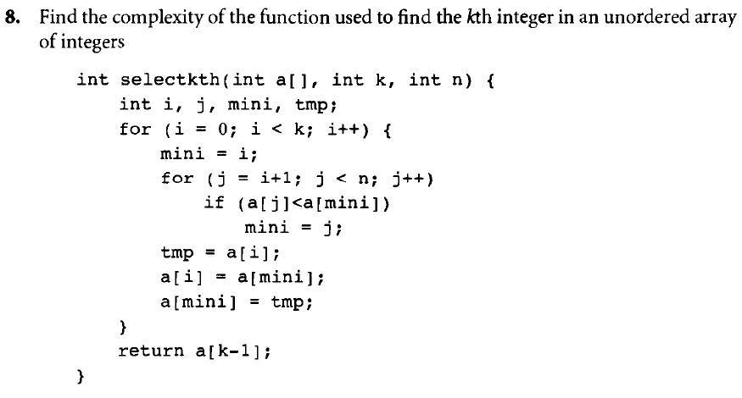
Find the complexity of the function used to find the kth integer in an unordered array of integers. Let basic operation be comparison

